Slide 1


AQA English GCSE
Welcome.
“So Matilda’s strong young mind continued to grow, nurtured by the voices of all those authors who had sent their books out into the world like ships on the sea.”

Slide 2
AQA GCSE Literature and Language
Literature
Language
Paper 1, 11th May 2025 (1hr45mins)
Macbeth
Jekyll and Hyde
Paper 2, 19th May 2025 (2hr15mins)
An Inspector Calls/Lord of the Flies
Power and Conflict Poetry
Unseen Poetry
Paper 1, 21st May 2026 (1hr45mins)
Fiction
Explorations in creative reading and writing
Paper 2, 5th June 2026 (1hr45mins)
Non-Fiction
Writers' viewpoints and perspectives

Slide 3
Literature
How to prepare:
Revise plot
Revise characters
Revise themes
Revise context
Revise key quotations

Slide 4
Plot

Slide 5
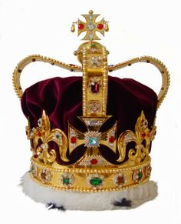
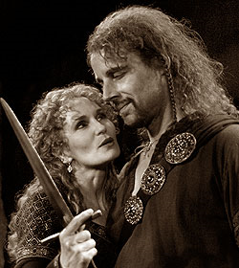
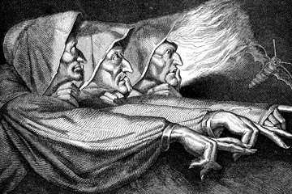
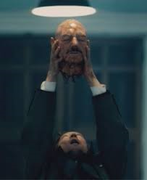
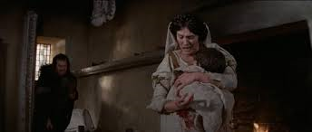
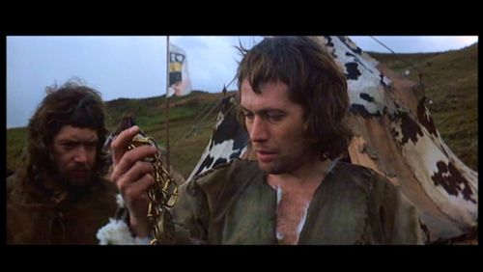
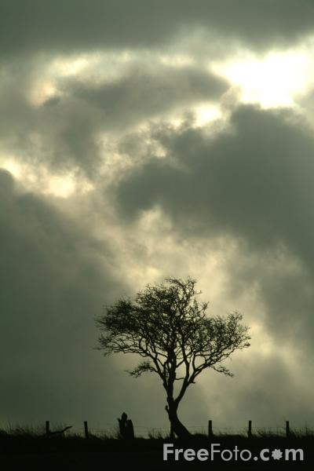
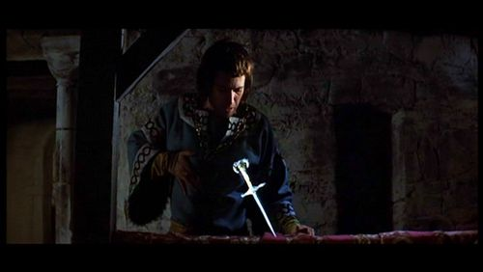
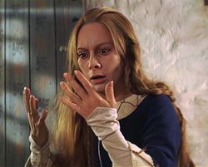
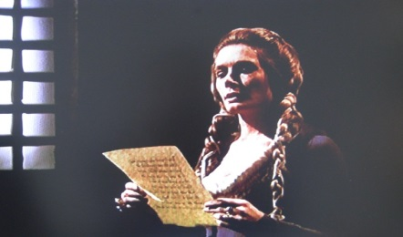
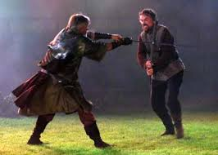
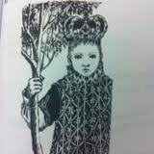
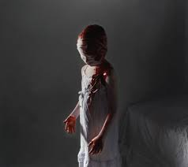
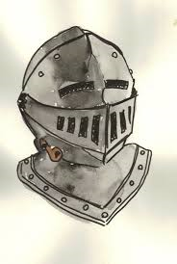
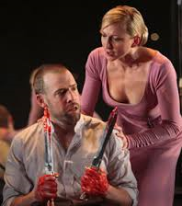
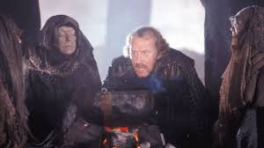
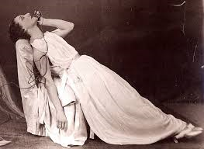
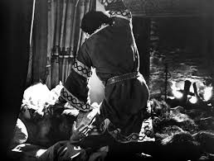
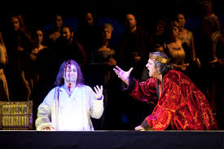
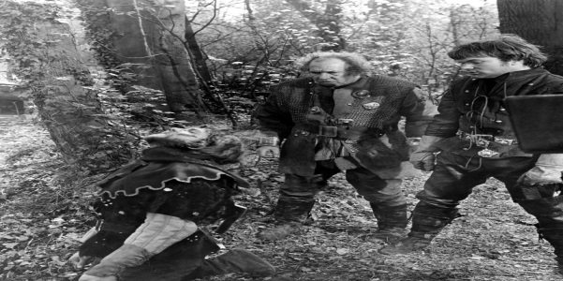

Slide 6


Slide 7


Slide 8
Context

Slide 9
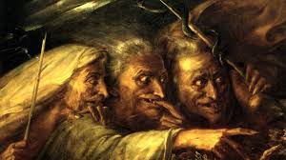
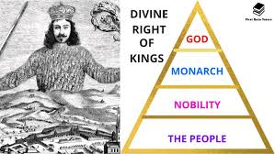
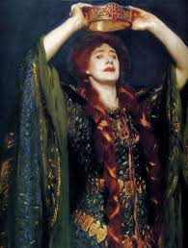

The supernatural
The divine right of kings and the chain of being
Macbeth Context
The role of women and subversion of gender stereotypes
Rule and kingship

Slide 10
The supernatural
Witches/Prophecies:
Catalysts of Macbeth's actions
"Fair is foul, and foul is fair"
Influence on Macbeth's ambition
Visions and Hallucinations:
Macbeth's guilt and mental instability (dagger, Banquo's ghost)
Fate vs. Free Will:
Are Macbeth's actions predetermined?
Role of supernatural forces in shaping events
Superstitions in Jacobean Era:
Fear of witches and dark magic
Belief in supernatural as evil forces

Slide 11
The role of women and subversion of gender stereotypes
Lady Macbeth:
Subverts traditional gender roles by encouraging ambition and violence
Influence over Macbeth: “unsex me here”
Mental breakdown and guilt in the end
Witches:
Represent chaos and inversion of natural gender roles
Malevolent forces that manipulate men
Women in Jacobean Society:
Expected to be subservient, yet women in the play are powerful
Limited agency but immense influence over men

Slide 12
The divine right of kings and the chain of being
Great Chain of Being:
Hierarchical structure of the universe, with the king as God's representative on Earth
Macbeth disrupts this order by killing Duncan
Natural vs. Unnatural:
Disruption of natural order: unnatural events like Duncan’s murder, strange omens (horses eating each other)
The natural world reacts violently to human disruption of divine order
Restoration of Order:
Malcolm’s coronation at the end restores balance and order in Scotland
Symbolizes the re-establishment of divine order

Slide 13
Rule and kingship
Divine Right of Kings:
Kings chosen by God, Macbeth violates this by killing Duncan
Importance of legitimate succession
Duncan vs. Macbeth:
Duncan as a just and benevolent king
Macbeth as a tyrant and usurper
King James I's Influence:
Play's homage to James I (descendant of Banquo)
Concerns about regicide and kingship stability
Order vs. Chaos:
Macbeth’s reign brings disorder to Scotland
Symbolic disruption of natural order due to illegitimate kingship

Slide 14
BBC iPlayer - Shakespeare: Rise of a Genius - Series 1: Episode 3
5 - 12 mins - Death of Elizabeth and how this impacts Shakespeare, James I.
23 mins - 38 mins - Gun Powder Plot, Macbeth and Catholicism
Social, historical and cultural context in Macbeth - The world of the play - GCSE Drama Revision - WJEC - BBC Bitesize
Macbeth by William Shakespeare | Context (youtube.com)

Slide 15
Theme

Slide 16
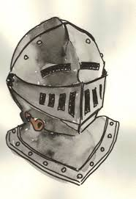
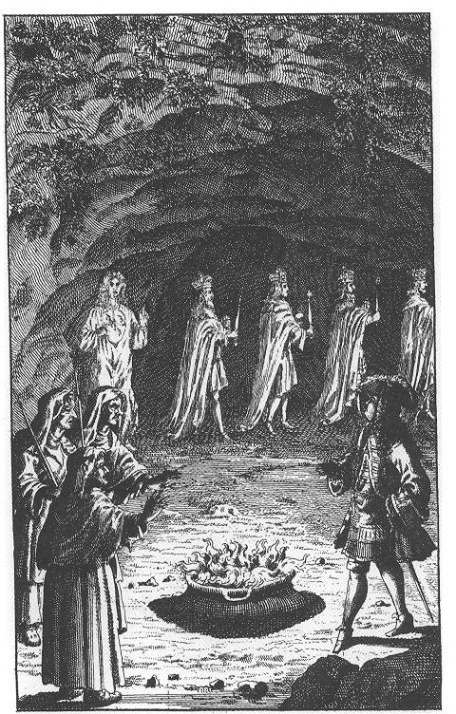

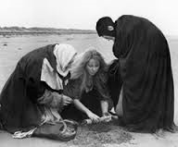
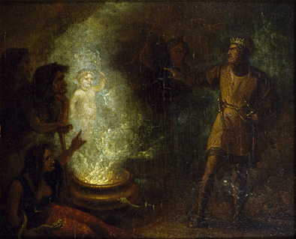
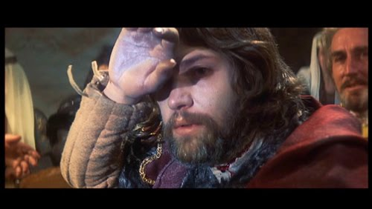
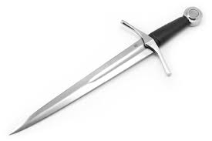
Starter – what links all these images?

Slide 17
Cultural context
James I was interested in witchcraft- published a book: Daemologie
Women who did not quite fit into society were classed as witches
Hell and witches were real to people at the time
Disastrous natural phenomena were blamed on the supernatural
Anxieties, fears, worries about the supernatural were a part of life for the Jacobeans

Slide 18
LQ How do we trace a theme in the text?
References to supernatural:
Witches
Appearance
What they say
Character reactions to them and supernatural in general (Macbeth, Banquo and Lady Macbeth)
Dagger
Porter
Ghost
The other apparitions

Slide 19
Thunder and lightning
Stage directions immediately signal to the audience that these characters are evil. Shakespeare foregrounds the theme of the supernatural to the audience
Witches
Macbeth
Supernatural
Banquo
Lady Macbeth
Other references

Slide 20
Where can we see this scene in the play?
Act 1, scene 1 – the play actually……with the witches planning to meet with Macbeth establishing this as the key scene
Act 1, scene 3 – the witches appear after the battle and give their………….to Macbeth and Banquo. Macbeth is immediately intrigued. Banquo is more suspicious
Act 1, scene 5 – Lady Macbeth commands supernatural forces to ………..her become less feminine and more like a man
Act 2, scene 1 – Banquo feels a sense of …………………..just before the king is killed
Act 2, scene 1 – Macbeth sees an ……………..dagger in front of him on his way to Duncan’s chamber. He also comments that nature is somehow altered
Act 2, scene 2 - Macbeth is convinced he will never …………again as he has become evil
Act 2, scene 3 – Lennox comments that the weather had been …………..the previous evening
Act 3, scene 1 –In a soliloquy, Macbeth claims to have given his ………to the devil
Act 3, scene 2 – when talking about Banquo’s……….., Macbeth mentions night and the forces of evil
Act 3, scene 4 – Macbeth sees Banquo’s……………..
Act 4, scene 1 Macbeth meets the witches again who show him three…………….. He is given more prophecies
Act 5, scene 8 – When Macduff tells Macbeth he was ripped from his mother’s ……….., Macbeth realises he has been tricked by the witches
Apparitions opens prophecies ghost soul womb
murder Help foreboding terrible imaginary sleep
Themes:
The Supernatural
Important lines
Fair is ………, and foul is fair”
What are these so …………….and wild in their attire
Stay you ……………..speakers
What, can the …….. speak true?
To win us to our ……….., the instruments of darkness tell us truths
Unsex me here and fill me from the ……….to the toe topfull of direst cruelty
Take my milk for ………. You murdering ministers
A heavy summons lies like…………upon me
Nature seems………….
Macbeth does ……………………sleep
The night has been……………………….
Mine eternal jewel given to the common ………..of man
Night’s black agents to their ……………do rouse
Hence …………..shadow!
By the pricking of my thumbs, something ……………this way comes
I have supped full with ………………
I bear a ……………… life
And be those juggling fiends no more ……………that palter with us in a double sense
Wicked charmed unruly horrors horrible believed lead
Gall foul imperfect devil harm dead murder
Enemy withered crown preys
Cultural context – supernatural
James I was interested in…………..- published a book: Daemologie
Women who did not quite fit into…………. were classed as witches
Hell and witches were …………… to people at the time
Disastrous ………….. phenomena were blamed on the supernatural
Anxieties, fears, worries about the supernatural were a part of life for the ………………
Jacobeans society real
natural witchcraft

Slide 21
Macbeth
In this extract Macbeth has just been told he has been made Thane of Cawdor. He is speaking to Banquo
Macbeth Do you not hope your children shall be kings, When those that gave the thane of Cawdor to me Promised no less to them? BANQUO That trusted home Might yet enkindle you unto the crown, Besides the thane of Cawdor. But 'tis strange: And oftentimes, to win us to our harm, The instruments of darkness tell us truths, Win us with honest trifles, to betray's In deepest consequence. Cousins, a word, I pray you. MACBETH [Aside] Two truths are told, As happy prologues to the swelling act Of the imperial theme.--I thank you, gentlemen. Aside This supernatural soliciting
Cannot be ill, cannot be good: if ill, Why hath it given me earnest of success, Commencing in a truth? I am thane of Cawdor: If good, why do I yield to that suggestion Whose horrid image doth unfix my hair And make my seated heart knock at my ribs, Against the use of nature? Present fears Are less than horrible imaginings: My thought, whose murder yet is but fantastical, Shakes so my single state of man that function Is smother'd in surmise, and nothing is But what is not.
How does Shakespeare present the supernatural in this part of the play?
How does Shakespeare present the supernatural in the play as a whole?

Slide 22
Macbeth
What does this question show about Macbeth?
What does Banquo warn Macbeth about? How is his reaction different? What are the instruments of darkness?
Macbeth Do you not hope your children shall be kings, When those that gave the thane of Cawdor to me Promised no less to them? BANQUO That trusted home Might yet enkindle you unto the crown, Besides the thane of Cawdor. But 'tis strange: And oftentimes, to win us to our harm, The instruments of darkness tell us truths, Win us with honest trifles, to betray's In deepest consequence. Cousins, a word, I pray you. MACBETH [Aside] Two truths are told, As happy prologues to the swelling act Of the imperial theme.--I thank you, gentlemen. Aside This supernatural soliciting
Cannot be ill, cannot be good: if ill, Why hath it given me earnest of success, Commencing in a truth? I am thane of Cawdor: If good, why do I yield to that suggestion Whose horrid image doth unfix my hair And make my seated heart knock at my ribs, Against the use of nature? Present fears Are less than horrible imaginings: My thought, whose murder yet is but fantastical, Shakes so my single state of man that function Is smother'd in surmise, and nothing is But what is not.
Why does Shakespeare use an aside? What does this suggest about Macbeth? What are the two truths?
How is Macbeth conflicted at the start of this aside?
What might he be thinking about here?
Why does he use the word murder? Why is he shaken?
How does the last line link to the key idea of appearance and reality?

Slide 23
The Witches (Act 1, Scene 1 and Scene 3)
The play opens with the three witches, who introduce the theme of the supernatural. They meet in thunder and lightning, discussing their next meeting with Macbeth. Their famous line, "Fair is foul, and foul is fair," reflects the disruption of natural order and foreshadows the confusion between good and evil.
In Act 1, Scene 3, the witches provide the first supernatural prediction: they greet Macbeth with three titles—Thane of Glamis, Thane of Cawdor, and future king. Their prophecies set the plot in motion, as Macbeth begins to contemplate murder to fulfill these predictions.
2. The Floating Dagger (Act 2, Scene 1)
As Macbeth prepares to murder King Duncan, he sees a vision of a floating dagger. The dagger points toward Duncan’s chamber, guiding Macbeth to the crime. He questions whether it is a product of his mind or something supernatural: “Is this a dagger which I see before me, the handle toward my hand?”
This vision blurs the line between reality and the supernatural, highlighting Macbeth’s mental turmoil and guilt.
3. Banquo’s Ghost (Act 3, Scene 4)
After ordering Banquo’s murder, Macbeth is haunted by the appearance of Banquo’s ghost during a royal banquet. The ghost sits in Macbeth’s place, and only he can see it, leading to his erratic behavior in front of his guests.
This supernatural vision symbolizes Macbeth's overwhelming guilt and foreshadows his eventual downfall. Lady Macbeth tries to explain his outbursts as a common affliction, but Macbeth is deeply shaken.
4. Hecate and the Witches (Act 3, Scene 5)
Hecate, the goddess of witchcraft, rebukes the witches for meddling with Macbeth without consulting her. She tells them to meet Macbeth again and use more powerful supernatural forces to deceive him. She describes how she will give Macbeth a false sense of security through further prophecies, contributing to his overconfidence.
This scene reinforces the witches' manipulation of Macbeth, using supernatural means to ensure his eventual destruction.

Slide 24
5. The Apparitions (Act 4, Scene 1)
When Macbeth seeks out the witches for further guidance, they summon three apparitions:
A severed head warns Macbeth to beware of Macduff.
A bloody child tells him that no one born of a woman will harm him.
A crowned child holding a tree assures him that he will not be vanquished until Birnam Wood comes to Dunsinane.
These apparitions give Macbeth a false sense of invincibility, but their words are ambiguous, leading to his downfall when the prophecies come true in unexpected ways.
6. The Storm and Natural Disorder (Act 2, Scene 3)
After Duncan’s murder, there is a description of unnatural occurrences in Scotland: storms, earthquakes, and horses eating each other. This disruption in nature reflects the supernatural impact of regicide. Nature itself seems to revolt against the moral chaos unleashed by Duncan's murder.
7. Lady Macbeth's Sleepwalking (Act 5, Scene 1)
While Lady Macbeth’s sleepwalking can be seen as a psychological manifestation of her guilt, there is a supernatural undertone in her nocturnal behavior. She is seen compulsively washing her hands, trying to remove an invisible bloodstain, symbolizing her inability to escape the consequences of her actions.
Her famous line, “Out, damned spot! Out, I say!” echoes the supernatural sense of being haunted by unseen forces.

Slide 25
How does Shakespeare present the supernatural in this extract and in the play as a whole?
First part of your answer - Overall explanation of the theme with links to context and character. Remember to refer to key words in the question
Main part of your answer - A number of PEAD /PEEEPEL paragraphs focusing on how the theme is presented and the devices which are used –keep the question focus in mind and link to other themes, context, effect on audience and use of language. You should refer to both the extract and the play as a whole
Conclusion - Summing up of themes and characters – how they develop throughout the play

Slide 26
The attitudes of Macbeth and Banquo to the supernatural
Macbeth and the supernatural
How he reacts to the witches and their prophecies
How he acts and what he does
What he says when faced with the supernatural
How he is influenced by the supernatural throughout the play
What the audience think about him
Think about:
The witches
The prophecies
The dagger
Banquo’s ghost
Going back to the witches again
How he ends the play
Banquo and the supernatural
How he reacts to the witches and their prophecies
How he acts and what he does
How he is influenced by the supernatural
What he thinks about Macbeth
What the audience think about him
Think about:
The witches
The prophecies
How he feels about Duncan’s death
What he says about Macbeth’s achievements
Some sentence starters to help you:
There are a number of supernatural elements in the play such as…..
When Macbeth first meets in the witches….
In the extract it is clear to see that………………
Macbeth thinks that…..
Macbeth has been clearly influenced by the supernatural because……..
When Macbeth sees the dagger,……….
The appearance of Banquo’s ghost tells the audience that……
Macbeth goes back to the witches and they show him….
At the end of the play………….
Banquo’s attitude to the witches is……………….
Banquo thinks that……………
When Banquo………………………., we can see that……

Slide 27
Your opening paragraph to any / all of the Literature questions should offer an interpretation
In Macbeth, Shakespeare uses the supernatural as a driving force that shapes the characters' actions and the play's dark, ominous atmosphere. The inclusion of witchcraft plays on the very real fears of the Jacobean audience and appealed to the new monarch, James I, who had written a book, Daemonologie , on this subject. The way in which the fatally flawed Macbeth and his noble comrade, Banquo respond to the supernatural allows Shakespeare to explore the themes of fate, temptation, and the corruption of human will, leaving the audience to question whether characters are controlled by supernatural forces or by their own ambitions.

Slide 28
The introduction:
The supernatural is a key theme in the play because _____________ Macbeth and Banquo respond differently to supernatural influences This is because ____________________
Referring to the extract:
In the extract Macbeth responds to the supernatural in a certain way. He says “……………….” meaning that ________________. This gives the audience the impression that_____________ Shakespeare is showing us that___________________ He goes on to say that “……………” which shows us that_____________________ “…………….” is particularly effective because______________ We also see his response when he says that “……………………………” clearly indicating that_____________
Banquo, on the other hand, seems___________________________ as he says “……………………” telling the audience that _________________ This is important because it show us that__________________ Another way in which we see his attitude is when he mentions that “…………………………..” This implies that _____________________
Referring to the play as a whole:
At the start of the play, Macbeth________________________ He is described as “……….” giving us the impression that_______ After__________________, Shakespeare shows us Macbeth’s response when______
The line “…………………..” is particularly effective as_________________ Banquo is very different as he___________________ We can see this when_____________________________ His line “…………………….” show us that _____________________
Conclusion
It is clear to see that _________________________________

Slide 29
Character

Slide 30
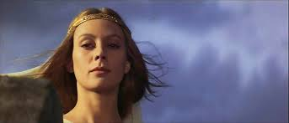
Starter – what is she like?
x10

Slide 31
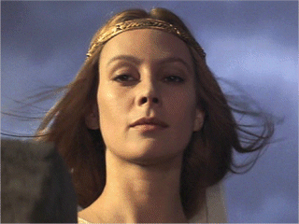
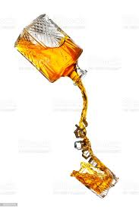
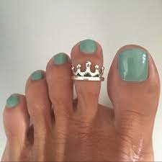
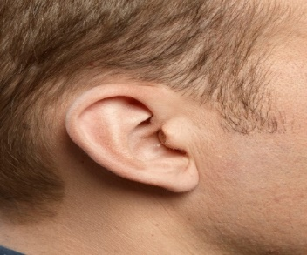
Looking back – key quotations
1
2

Slide 32

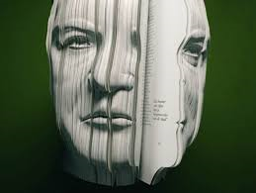
Looking back – key quotations
3
4

Slide 33


Looking back – key quotations
5
6

Slide 34
Lady Macbeth
When does he appear in the play?
Act 1, scene 5 – …………. a letter from Macbeth and decides the king must die
Act 1, scene 6 – welcomes Duncan warmly to the castle, showing how ……………………..she is
Act 1, scene 7 – persuades a doubtful Macbeth to go ahead with the …………….
Act 2, scene 2 - – takes the ……………..back to Duncan’s bedchamber when Macbeth cannot do it
Act 2, scene 3 – faints to draw attention way from……………after the murder
Act 3, scene 2 – advises Macbeth to stop thinking about what he has……..
Act 3, scene 4 – She has to lie to the ……………at the feast as Macbeth is acting strangely
Act 5, scene 1 – is overheard talking about the murders of Duncan and Lady……………….
Macduff Macbeth receives murder done Thanes daggers two-faced
What do we know about this character?
A loyal and loving wife
She is strong and almost…………….
Ambitious and wants to take ……………….as soon as she hears about the witches’ prophecy
Could be considered ……………as she immediately thinks of killing Duncan
She ……………………Macbeth and convinces him he should kill the king
Plans and ………….the murder
Steps in when Macbeth cannot take the daggers back claiming she is not frightened of having……………on her hands
………………for Macbeth at the feast when he starts seeing things
Gradually becomes more ……….from Macbeth
Eventually starts sleepwalking and imagines she sees blood on her ………….
She dies
Distant masculine evil hands covers charge manipulates arranges blood
Important lines
That I may pour my …………. In thine ear
………. me here and fill me from the crown to the toe topfull of direst cruelty
Look like the innocent…………… but be the serpent under ‘t
I would while it was smiling in my face, have plucked my nipple from his boneless gums and……….the brains out
My hands are of your ……………. but I shame to wear a heart so white
Sleek over your ………………looks
Are you a ………?
What quite …………….in folly?
Out …………spot! Out, I say!
All the perfumes of Arabia will not …………… this little hand
Sweeten damned man spirits unsex rugged unmanned colour flower dashed
How does she link to theme and context?
Most obviously links to role of……………. as she acts in a way which a Shakespearian audience would have found shocking. She wants to lose all her traditionally feminine qualities and become more like a warrior
She could be seen as another …………………. as she tries to manipulate and control her husband and carry out wicked acts. (Supernatural)
She also links to the theme of ………………… as she is called a fiend-like …………at the end of the play
rule women witch queen

Slide 35
How does Shakespeare present Lady Macbeth as a strong character in this extract and the play as a whole?
First part of your answer - Overall explanation of the character with links to context and theme. Remember to refer to key words in the question
Main part of your answer - A number of PEAD /PEEEPEL paragraphs focusing on how the character is presented and the devices which are used –keep the question focus in mind and link to theme, context, effect on audience and use of language. You should refer to both the extract and the play as a whole
Conclusion - Summing up of character – how she changes and develops throughout the play

Slide 36
What are you trying to do in your answer on Macbeth?
Show that you understand how the character is presented in the extract and the play as a whole
Take evidence from the extract and the play as a whole
Explain what this language means
Analyse how Shakespeare is using language (metaphors, similes, etc) and what impression it gives us of the character. Here is where you try to really explore the ways in which Shakespeare puts across what she is like, how she links to themes and big ideas and how she ties into cultural context
You could also mention stagecraft and devices such as dramatic irony

Slide 37
Lady Macbeth
Think about:
In the extract
What she says about Duncan
What she says to Macbeth
How she talks to Macbeth
What connotations and suggestions some of the words she uses have
The instructions she gives Macbeth
Any figurative language
In the play
Other examples of her strength
What she says and does
What her actions and speech tell us
What Shakespeare is trying to show us
Some sentence starters to help you:
Shakespeare presents Lady Macbeth as___
When she first speaks she says “………..”
In the extract it is clear to see that____
Lady Macbeth thinks that_____
The use of “…………..” Tells the audience that__________
When Shakespeare writes that “……….”, it tells us______
When she speaks to Macbeth, she says “……..”
In act1/2/3/4, she__________
The incident with the ______clearly shows us that___________
After__________, we get the impression that_______

Slide 38
Starting with this speech, explain how Shakespeare presents Lady Macbeth as a strong character
LADY MACBETH
O, never Shall sun that morrow see! Your face, my thane, is as a book where men May read strange matters. To beguile the time, Look like the time; bear welcome in your eye, Your hand, your tongue: look like the innocent flower, But be the serpent under't. He that's coming Must be provided for: and you shall put This night's great business into my dispatch; Which shall to all our nights and days to come Give solely sovereign sway and masterdom.

Slide 39
Subject matter / inference
Lady Macbeth is speaking to Macbeth after he has returned from battle
Starting with this speech, explain how Shakespeare presents Lady Macbeth as a strong character
Language/devices
Adverb indicates intent – she is determined that Duncan will die that night
LADY MACBETH
O, never Shall sun that morrow see! Your face, my thane, is as a book where men May read strange matters. To beguile the time, Look like the time; bear welcome in your eye, Your hand, your tongue: look like the innocent flower, But be the serpent under't. He that's coming Must be provided for: and you shall put This night's great business into my dispatch; Which shall to all our nights and days to come Give solely sovereign sway and masterdom.
Themes and links to other parts of the play (jot down quotations here)
She is commanding as she was when demanding that the spirits “unsex” her
Contextual factors
Does not conform to stereotype of Jacobean woman

Slide 40
What does she tell him to do at the end of the speech?
Would you expect Macbeth to take orders from his wife?
Who is she talking to?
How does she talk to him?
Who is she talking about?
What has she decided?
LADY MACBETH
O, never Shall sun that morrow see! Your face, my thane, is as a book where men May read strange matters. To beguile the time, Look like the time; bear welcome in your eye, Your hand, your tongue: look like the innocent flower, But be the serpent under't. He that's coming Must be provided for: and you shall put This night's great business into my dispatch; Which shall to all our nights and days to come Give solely sovereign sway and masterdom.
Why does she use the metaphor of the serpent and the flower?
Which techniques can you see here?
Which biblical story does it link to?
What does this make her sound like?
What does she say about Macbeth’s face?
Why is this important?
Which theme does it link to?
Why is it an effective metaphor?
Does she behave in a way that a typical Jacobean women would be expected to behave?
How does she tell him to act?
Should a loyal subject act in this way?
What sort of verbs does she use when talking to her husband?

Slide 41
Subject matter / inference
Lady Macbeth is speaking to Macbeth after he has returned from battle
She take charge of the conversation giving him orders and advice
Starting with this speech, explain how Shakespeare presents Lady Macbeth as a strong character
Language/devices
Adverb indicates intent – she is determined that Duncan will die that night
Lots of figurative language linking to appearance and reality
Biblical allusions to serpent – original sin and evil
Imperative verbs indicating commanding nature and desire to dominate
LADY MACBETH
O, never Shall sun that morrow see! Your face, my thane, is as a book where men May read strange matters. To beguile the time, Look like the time; bear welcome in your eye, Your hand, your tongue: look like the innocent flower, But be the serpent under't. He that's coming Must be provided for: and you shall put This night's great business into my dispatch; Which shall to all our nights and days to come Give solely sovereign sway and masterdom.
Themes and links to other parts of the play (jot down quotations here)
She is commanding as she was when demanding that the spirits “unsex” her
Takes charge directly after the murder of Duncan (daggers and hands) and at the feast (“Are you a man?”)
Gradually loses her mind and sees blood on her hands
Contextual factors
Does not conform to stereotype of Elizabethan woman – she challenges traditional gender roles
Obvious links to witches and supernatural – evil and malicious

Slide 42
Lady Macbeth is a strong female character who takes control of events early on in the play. She is able to manipulate her husband, plan a murder and cover for Macbeth when he starts to lose his mind. She undermines stereotypical notions of the female norm in Jacobean society but eventually pays for this transgression with her life.
Shakespeare presents her as a strong character here and in the rest of the play in a number of ways. This speech which comes from act 1 of the play shows Lady Macbeth speaking to her husband after he has returned from battle. She is the one who takes charge immediately, telling Macbeth that Duncan, who is due at arrive at Dunsinane later, “never that sun shall morrow see”. This tells the audience that she has already decided that the king will die. The use of the modal verb “shall” is particularly effective as it suggests that there is no doubt in her mind that the king must be murdered, giving us the impression that she is strong-minded and decisive; traits which would not normally be associated with a Jacobean lady. Just before this speech she had demanded that the spirits “unsex” her, giving her characteristics usually associated with men at the time. Shakespeare is showing us how she is prepared to give up her feminine passivity in order to become stronger and more active so she can achieve her ambition of making Macbeth king.
Can you identify:
Overall summing up of character
Point
Use of evidence
Subject terminology
Analysis of language and techniques
Reference to contextual factors
Pupil copy

Slide 43
Lady Macbeth is a strong female character who takes control of events early on in the play. She is able to manipulate her husband, plan a murder and cover for Macbeth when he starts to lose his mind. She undermines stereotypical notions of the female norm in Jacobean society but eventually pays for this transgression with her life.
Shakespeare presents her as a strong character here and in the rest of the play in a number of ways. This speech which comes from act 1 of the play shows Lady Macbeth speaking to her husband after he has returned from battle. She is the one who takes charge immediately, telling Macbeth that Duncan, who is due at arrive at Dunsinane later, “never that sun shall morrow see”. This tells the audience that she has already decided that the king will die. The use of the modal verb “shall” is particularly effective as it suggests that there is no doubt in her mind that the king must be murdered, giving us the impression that she is strong-minded and decisive; traits which would not normally be associated with a Jacobean lady. Just before this speech she had demanded that the spirits “unsex” her, giving her characteristics usually associated with men at the time. Shakespeare is showing us how she is prepared to give up her feminine passivity in order to become stronger and more active so she can achieve her ambition of making Macbeth king.
Can you identify:
Overall summing up of character
Point
Use of evidence
Subject terminology
Analysis of language and techniques
Reference to contextual factors
Pupil copy

Slide 44
Extra help
How to set out our answer:
Referring to the extract:
Another way in which Lady Macbeth is shown to be strong is when she says “………………..”. This means that_______________ and gives the audience the impression that_____________ Shakespeare is showing us that___________________
Lady Macbeth goes on to say that “……………” which shows us that_____________________ The use of “…………….” is particularly effective because___________________
We are also given the impression that she is strong when Shakespeare writes that “…………………..” telling us that _____________ This suggests that____________
Referring to the play as a whole:
At the start of the play, Lady Macbeth ________________________ She is described as “……….” giving us the impression that_______
After__________________, Shakespeare presents Lady Macbeth as strong when______
The line “…………………..” is particularly effective as_________________
Another way Shakespeare focuses on her strength is when____
However, at the end of the play____________________

Slide 45
To introduce points
At the start of the soliloquy…..
When Lady Macbeth says….
We see that Lady Macbeth has become…..
The audience gets the impression that….
It is clear to see that….
It is apparent that……..
At this point in the play…..
When Shakespeare uses……
The use of……….
The playwright goes on to say that…
To introduce comments
This suggests……
This implies….
This metaphor/simile is used because…
This gives us the impression that…..
It could be said/argued that…..
We get the impression that……
The audience gets the impression that……
The playwright uses……..to show us…….
This links back to…….

Slide 46
How does the poet present the effects of war on children?
Children In Wartime by Isobel Thrilling
Sirens ripped open the warm silk of sleep; we ricocheted to the shelter
moated by streets
that ran with darkness.
People said it was a storm,
but flak
had not the right sound for rain; thunder left such huge craters
of silence, we knew this was no giant
playing bowls. And later, when I saw the jaw of glass,
where once had hung my window spun with stars; it seemed the sky lay broken on my floor.
Glossary:
Ricochet - rebound/bounce like a bullet
Flak - anti-aircraft fire

Slide 47
Some points/questions to help you:
Age of speaker/perspective?
What does the title now suggest?
Does the poem have more than one voice?
Does it use a form you are familiar with?
Is there a turning point in the poem?
Is there any sense of progression?
Do the stanzas deal with related issues? Are there links and connections?
Can you see words related to a particular idea – a semantic field?
Does the poet use extended metaphor/symbols? Does the poet use any other techniques/devices?
How is contrast used in the poem?
Can you see any alliteration? Why is this used?
Can you spot any rhetorical devices?
Any other important lexical choices – verbs/adjectives/nouns?

Slide 48
Extra Help
How is the child awakened? Why is “ripped open the warm silk of sleep” so effective?
How does the verb ricochet tell us they made their way to the shelter?
Why is so dark? Is this another danger or could it keep them safe?
Why use the verb “moated”? What do we usually associate with moats?
How does the poet use sounds in the poem?
What stories have adults told the child in order to explain the bombing?
How does the poet show us that the child is beginning to doubt what the adults are telling her?
Why is the description of the broken window so effective? What does the child feel about this?
What does the end of the poem symbolise in terms of the child’s understanding of the situation?

Slide 49
Why use this verb?
What kind of action does it suggest? What connotations does the word have?
Why use this noun? What are they sheltering from?
we ricocheted to the shelter
moated by streets
that ran with darkness.
What does this verb suggest? What is the poet trying to put across?

Slide 50
The key to doing well on this paper:
Read the poem carefully
Try to understand that the poem is dealing with a major theme/idea or issue. (There might be more than one)
You need to identify what this is
Analysis of features will then be pretty straightforward
Use quotations and comment on language.

Slide 51
How does the poet present the effects of war on children?
Introduction - What is the poem about? What is the big idea or theme?
Have you inferred anything about the attitude? Is the title important?
Feelings - What feelings or emotions are put across? Do they change?
Techniques - How does the poet convey her attitude? What techniques are used?
Language and devices?
Conclusion - Refer back to question with overall summing up
Help with phrasing your response

Slide 52
How do I write up my notes?
Introduction
Children In Wartime by Isobel Thrilling is about____________ It focuses on_______________
The poet is_______________
Feelings/techniques
The poet uses a number of techniques to show us the effects of war on children. For instance, she writes that “…………………………………….” This is effective because_________________. Thrilling also uses a (name device) in the line “……………………………..” This tells us that ____________________________. When she writes that “………………………………..” it gives us the impression that __________________
The poet then goes on to describe______________ writing that “……………………….” The reader is given the impression that_______________ The use of (Name device) in the line “…………………” shows us that __________________ We can clearly see the poet thinks that_______________________ when she writes that “……………………..”, it implies that____________________
Conclusion
Overall, we can see that_______________ The poet has___________________

Slide 53
Introduction – overall interpretation
Children in Wartime by Isobel Thrilling tells the story of a child being awoken by an air raid. The poem seems to be set during WW2 and could well be an autobiographical account of an incident that the poet actually experienced. By the end of the poem, it would appear that the child has lost their previous innocence and is now aware of the real dangers she is facing.

Slide 54
The poet shows us the devastating effects of war on children in the first line writing that “sirens ripped open the warm silk of sleep”. This tells us that the children are woken up as an air raid is taking place. She makes this sound brutal with the use of the metaphor “ripped open” suggesting that the sudden deafening sound of the siren acts like a knife cutting through the “warm silk of sleep”. The poet presents the children as almost cocooned and protected in their beds before being violently awoken. The soft sibilance of “silk” and “sleep” contrast greatly with the urgency of the warning, indicting that harsh reality of war is entering the children’s lives.
Point
Evidence
Explanation
Analysis/evaluation/comment

Slide 55
The poet shows us the devastating effects of war on children in the first line writing that “sirens ripped open the warm silk of sleep”. This tells us that the children are woken up as an air raid is taking place. She makes this sound brutal with the use of the metaphor “ripped open” suggesting that the sudden deafening sound of the siren acts like a knife cutting through the “warm silk of sleep”. The poet presents the children as almost cocooned and protected in their beds before being violently awoken. The soft sibilance of “silk” and “sleep” contrast greatly with the urgency of the warning, indicting that the harsh reality of war is entering the children’s lives.
Point
Evidence
Explanation
Analysis/evaluation/comment

Slide 56
Language
How to prepare:
Know how to answer the questions
Be ready for the writing tasks

Slide 57
Key Skills - PEEEPEL
P | Point | Make a clear point related to the question being asked.
E | Evidence | Use evidence (quotation) from the text.
E | Explain | Explain what the quotation means, what is happening at this moment in text.
E | Explore | Explore the quotation – ‘zoom in’ on key words, explore the connotations, use subject terminology.
P | Purpose | Explain the purpose of the quotation, why is it important, why did the author/poet include this?
E | Emotion | Consider what emotion an audience/reader is meant to feel.
L | Link | Link comments made to the context or themes/motifs in the text

Slide 58
Key Skills – Exploding Quotations
Birling wishes to see himself this way, he believes it is a positive, however it has also made him hard hearted.
Personal Pronoun connotes his self-centred character and his ability to make situations about him.
Adjective could be seen as a positive connoting strength, as if he is hard as rock.
‘ I speak as a hard headed practical man of business’
Mr Birling, An Inspector Calls
Highlighting that Mr Birling is a social climber.
Indefinite article shows how Mr Birling represents all businessmen in society.
Alliteration, draws attention to characteristics, demonstrating his egotistical nature.

Slide 59

Key Skills – Writing Skills
Both Language papers will require students to complete an extended writing task.
Paper 1 – Story or a description
Paper 2 – A piece of non – fiction (letter/article/speech etc.)
40 marks – 45 minutes
Plan – 5 minutes
Write – 35 minutes
Edit – 5 minutes
It is not all about what is written but how it is written – structural devices, language features and SPaG are key.

Slide 60
Starter
Success criteria for descriptive writing
1) Use of ………………. (hear, taste, sight, smell, touch)
2) Powerful a…………../a…………./v………./n……….
3) Figurative language – m…………..s, s……s, personification, onomatopoeia, alliteration
4) Sentence o………..s variation.
5) Sentence l…………….s variation.
6) Sophisticated punctuation (question marks, ellipses, semi-colons)
7) Correct SPAG

Slide 61
Starter
Success criteria for descriptive writing
1) Use of senses (hear, taste, sight, smell, touch)
2) Powerful adjectives/adverbs/verbs
3) Figurative language – metaphors, similes, personification, onomatopoeia, alliteration
4) Sentence openings variation.
5) Sentence lengths variation.
6) Sophisticated punctuation (question marks, ellipses, semi-colons)
7) Correct SPAG

Slide 62
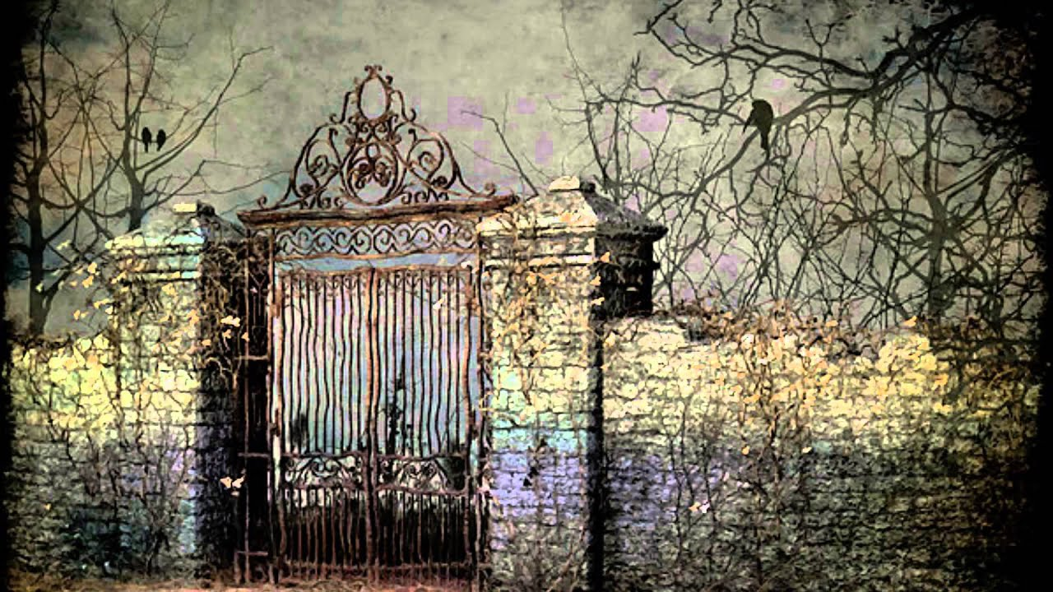
LQ How do we write in an interesting way?
When writing a descriptive piece, you need to go into detail when describing content
Think about:
Colour
Texture
Size
Material
Age / state of repair
Movement
Smell
Sound
Number
Creaking painfully on its worn-out hinges, the huge gate looked ready to give up and collapse. What had once been a sturdy barrier to potential intruders now hung forlornly, black paint flaking away to reveal patches of rust that spread over the metal like a brown fungal growth.

Slide 63
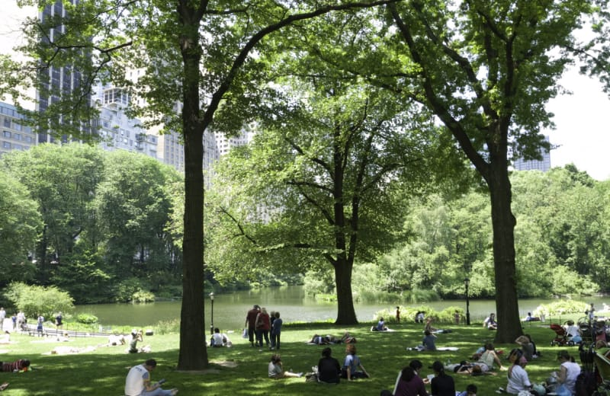
LQ How can we plan under timed conditions?
Write a description suggested by this picture

Slide 65
A descriptive writing task based on a picture
Make sure your writing has some sort of structure:
Temporal – paragraphs focus on different parts of a day for instance
Locational – zoom in on various elements and describe them – there might be enough in the picture
Positional – try to write about things from a particular perspective or point of view
Plan before you begin so that you know the path your writing will take – you can organise your ideas around various headings: these will become the topics for each paragraph
Think carefully about sentence types and how to start sentences – ISPACE! Remember that not all your sentences need to be long and complex. Variety is the key!
Language and devices – imagery, word choice, connotation, techniques. Think about mood and tone. Don’t be too wordy or ornate. Sometimes it isn’t necessary!
Accuracy – this doesn’t just mean spelling and punctuation! Think about the tense you ae writing in and stick to one! Make sure that sentences actually make grammatical and logical sense.
Finally – remember your purpose – description should be enjoyable, entertaining and original

Slide 67
What is in the background? Colours ? Appearance? Can you imagine what an apartment looks like inside?
Time of day – will this change as writing progresses?
What types of trees are there? Birds and animals? Textures? Sounds? Sights?
Could you bring the description to a close using the idea of time passing?
Family groups – think about appearance, movement, facial expressions
What about the grass and the paths? Textures and sounds at ground level
Could you imagine anything else which is not perhaps visible in the picture?
How does the pond look? What does it sound like? Fountains? Anyone boating?
Couples? Joggers? Mums and dads? Picnics?

Slide 68
Towering skyscraper , shimmering glass. Cool interior with sunlight cutting though slanted blinds
Perfect blue sky dotted with clouds
enormous oaks stand like sentinels / green leaves rustling
Setting sun – late afternoon – people start to leave
Family groups – think about appearance, movement, facial expressions
Thick and lush green carpet of grass / clusters of golden daffodils heads swaying in the breeze
Perhaps a café or ice-cream van- queues and colours. The terrace with happy families
How does the pond look? What does it sound like? Fountains? Anyone boating?
Lounging on blankets / making daisy chains
Loving couples arms intertwined / red faced toddlers / children’s laughter echoing

Slide 69
P1 – Morning and description of skyscrapers – someone looking over park
P2 – move down to trees – birds and animal life
P3 – lake and appearance – imagine boats and activities
P4 – Focus on people – groups, couples, children, picnics
P5 – Focus on café or ice-cream van – zoom in on individuals
P6 – Late afternoon and people start to leave park – sun goes down to give writing a structure

Slide 70
P1:
As the morning sun rises, it casts a golden glow over the towering skyscrapers that surround the park, creating a breath-taking skyline.
P2:
Descending from the heights of the buildings, the eye is drawn to the lush trees that form a vibrant canopy, alive with the songs of chirping birds and the playful antics of small animals.
P3:
At the heart of the park lies a shimmering lake, its surface sparkling like diamonds as boats glide smoothly across, inviting all sorts of activities and leisurely adventures.
P4:
Scattered throughout the park, groups of friends laugh and share stories, couples stroll hand in hand, and children dash about, their giggles filling the air as they enjoy picnics on the grass.
P5:
Nestled under the shade of an old oak, a charming café buzzes with energy, while an ice-cream van draws delighted children eager for a sweet treat, creating moments of joy and connection.
P6:
As the late afternoon sun begins to dip below the horizon, a gentle calm settles over the park, and families start to pack up, leaving behind the fading warmth of a perfect day.

Slide 71
From the balcony of the tallest skyscraper, the city stretched below like a living map—streets glinting in the sunlight, cars crawling like metallic beetles. The glass panels around the balcony shimmered with reflected light, throwing fragments of gold across the man’s face as he leaned on the railing. A faint breeze tugged at his sleeve, carrying with it the distant hum of laughter and life from far below. For a moment, he stood perfectly still, suspended between the quiet calm of the clouds and the restless rhythm of the city beneath him.
Below, the park was a patchwork of green and gold, the trees shifting gently in the warmth of the afternoon sun. Each branch seemed to pulse with light, the leaves whispering secrets to the wind. Sunbeams filtered through the canopy, spilling across the grass in dappled patterns where families lounged and children raced between the trunks. The air shimmered with the scent of freshly cut grass and the hum of bees, a soft, natural heartbeat in the centre of the concrete maze.

Slide 72
Write the opening of a story with the title: The Journey

Slide 73
1. Who is making the journey?
Who is your main character?
How old are they?
What motivates them to go on this journey? (e.g. escaping, searching, proving something)
How do they feel at the start — excited, nervous, angry, lost?
2. Where and when does the journey take place?
Is it set in the past, present, or future?
What kind of place is it? (city, desert, mountain, road, train, sea, etc.)
What time of day or season is it?
What can the character see, hear, and smell as the journey begins?
3. Why is the journey important?
What is the goal or destination?
What might happen if they don’t make it?
Is there a deeper meaning to the journey (e.g. self-discovery, change, loss)?
4. What obstacles or tension could appear early on?
What goes wrong, or feels “off,” as the journey starts?
Is there bad weather, danger, a difficult choice, or inner conflict?
How does the character react?
5. How will you hook the reader?
Can you start with action, dialogue, or description?
What small detail could make the reader curious?
What kind of mood do you want to set — suspenseful, mysterious, emotional, hopeful?
6. What will your opening paragraph do?
Introduce the setting and atmosphere
Give a glimpse of the character’s thoughts or feelings
Hint at what’s coming next

Slide 74
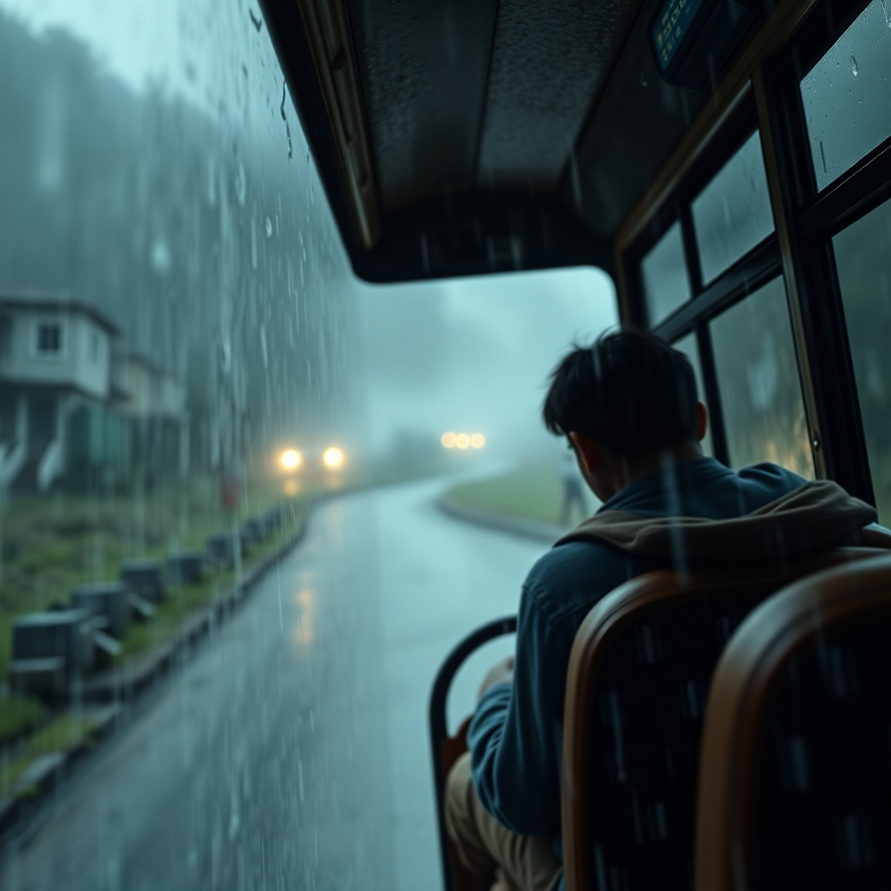
It was a normal day and I was going on a journey. I didn’t know what would happen next, but I hoped it would be fun. I packed my things and got in the car.
Why it’s weak:
The rain hammered against the windscreen as the old bus groaned up the mountain road. Every jolt sent a shiver through the metal frame—and through me. Somewhere beyond the mist, the village waited, and with it, the answer I’d spent a year chasing.
Why it’s strong:

Slide 75
It was a normal day and I was going on a journey. I didn’t know what would happen next, but I hoped it would be fun. I packed my things and got in the car.
Why it’s weak:
The rain hammered against the windscreen as the old bus groaned up the mountain road. Every jolt sent a shiver through the metal frame—and through me. Somewhere beyond the mist, the village waited, and with it, the answer I’d spent a year chasing.
Why it’s strong:

Slide 76
It was a normal day and I was going on a journey. I didn’t know what would happen next, but I hoped it would be fun. I packed my things and got in the car.
Why it’s weak:
Vague and predictable: Uses general words like “normal” and “fun” without detail or emotion.
No hook: Doesn’t make the reader curious or engaged — nothing unusual or striking happens.
Flat tone: Sentences are short and repetitive without variety or atmosphere.
Tells, doesn’t show: We’re told what’s happening, but can’t see or feel it.

Slide 77
The rain hammered against the windscreen as the old bus groaned up the mountain road. Every jolt sent a shiver through the metal frame—and through me. Somewhere beyond the mist, the village waited, and with it, the answer I’d spent a year chasing.
Why it’s strong:
Creates atmosphere: The weather, sound, and movement build tension and mood.
Immediate setting: We know where we are and can visualise the scene clearly.
Emotional connection: The narrator’s nervousness adds intrigue.
Sense of purpose: “The answer I’d spent a year chasing” hints at mystery and

Slide 78
Paragraph 1 – Setting the Scene
Purpose: Introduce the setting, atmosphere, and character’s situation.
What to include:
Where and when the journey begins
Sensory description (what can be seen, heard, felt)
The mood or tone (e.g. tense, hopeful, nervous)
Sentence openers:
The morning air hung thick with…
As I stepped onto the platform/road/path, I felt…
Around me, the world seemed to hold its breath.
The engine coughed once before roaring to life.
It was supposed to be an ordinary journey, but…
Paragraph 2 – The Traveller’s Thoughts and Feelings
Purpose: Reveal more about the main character and their emotions or motivation.
What to include:
Why they are making the journey
How they feel about it (fear, excitement, regret, determination)
A small memory, thought, or hint about what lies ahead
Sentence openers:
I kept telling myself this was the right choice, but…
Every mile that passed pulled me further from…
My hands trembled as I checked my bag again.
People said I was foolish to try, yet something inside me refused to stay.
I couldn’t shake the feeling that something was waiting for me at the end.
Paragraph 3 – Building Tension or Action
Purpose: Introduce a change, challenge, or moment that hooks the reader.
What to include:
Something unexpected happens (weather turns, a strange noise, a problem)
Character reaction — how do they respond?
Use sensory language and short sentences for pace.
Sentence openers:
The road ahead suddenly vanished into fog.
Then I heard it — a sound that didn’t belong.
A flash of light cut through the darkness.
My heartbeat quickened as I realised…
That was the moment I knew this journey would change everything.

Slide 79
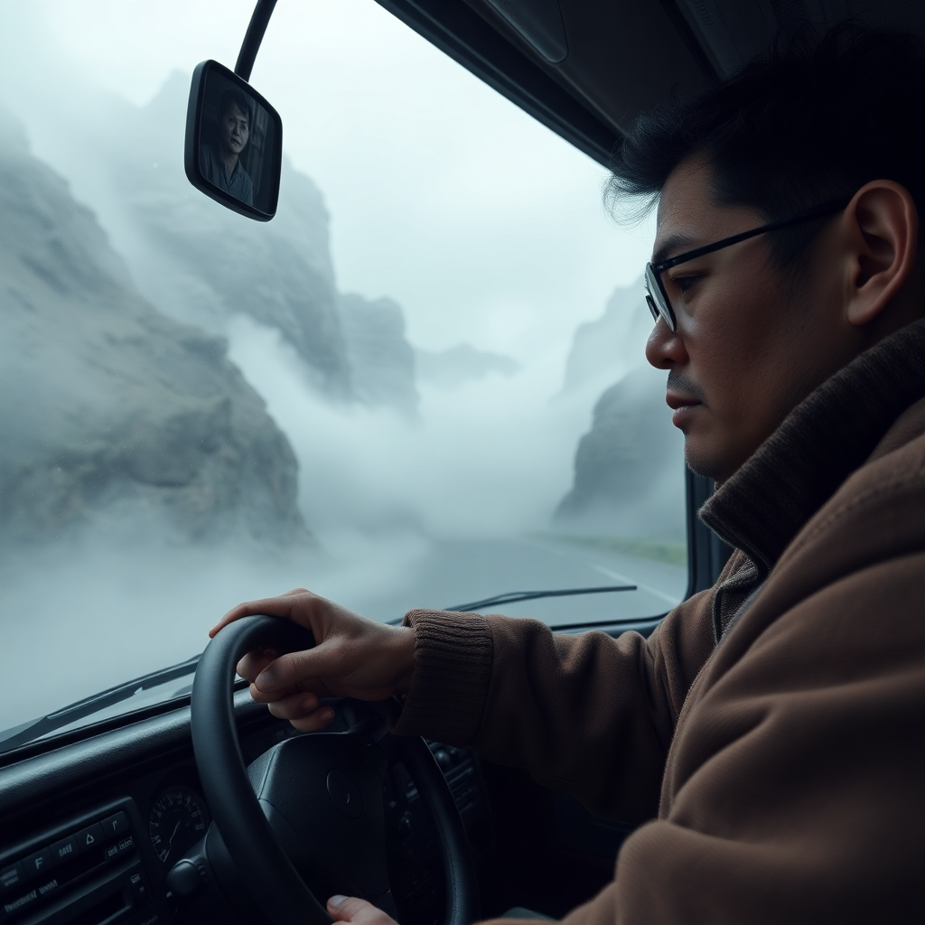
The wipers screeched back and forth, barely keeping the view clear as the road narrowed to a thread between cliffs and clouds. I clutched my bag tighter, feeling the worn leather dig into my palm. Inside was the photograph—the only clue I had left. The driver muttered something in a language I didn’t understand, his eyes flicking nervously to the rearview mirror. For a moment, I thought I saw a shadow move in the fog behind us. Then, the bus lurched forward, and the mountain swallowed everything else.
Why it’s strong:

Slide 80
The wipers screeched back and forth, barely keeping the view clear as the road narrowed to a thread between cliffs and clouds. I clutched my bag tighter, feeling the worn leather dig into my palm. Inside was the photograph—the only clue I had left. The driver muttered something in a language I didn’t understand, his eyes flicking nervously to the rearview mirror. For a moment, I thought I saw a shadow move in the fog behind us. Then, the bus lurched forward, and the mountain swallowed everything else.
1. Strong sensory detail
The description appeals to sight (“fog,” “narrowed to a thread between cliffs and clouds”), sound (“wipers screeched”), and touch (“worn leather dig into my palm”), helping readers vividly imagine the scene.
2. Builds tension and atmosphere
The combination of the storm, the narrow road, and the shadow in the fog creates suspense and unease, drawing readers in.
3. Effective pacing
Short sentences like “I clutched my bag tighter.” and “Then, the bus lurched forward.” quicken the rhythm, matching the nervous energy of the moment.
4. Emotional connection
The narrator’s anxiety (“clutched my bag tighter,” “the only clue I had left”) makes readers care about their journey and what’s at stake.
5. Clear narrative purpose
The reference to “the photograph” and “the only clue” pushes the story forward, hinting at a mystery or quest without revealing too much.
6. Subtle foreshadowing
The “shadow in the fog” and “nervous driver” suggest future danger or revelation, maintaining reader interest.
7. Consistent tone and style
The writing maintains a tense, cinematic tone that fits the title The Journey, keeping mood and imagery consistent throughout.

Slide 81
‘All sport should be fun, fair and open to everyone. These days, sport seems to be more about money, corruption and winning at any cost.’ Write an article for a newspaper in which you explain your point of view on this statement.
(24 marks for content and organisation 16 marks for technical accuracy) [40 marks)
Here you are given ideas / points which you need to expand on and turn into paragraphs. USE THEM!
Here you are given your form. As it is an article, the language should be formal and you should attempt to write a headline

Slide 82
All sport should be fun, fair and open to everyone. These days, sport seems to be more about money, corruption and winning at any cost.’ Write an article for a newspaper in which you explain your point of view on this statement.
Reason/point | Explanation / supporting evidence

Slide 83
Can you think of some points that will become paragraphs?

Slide 84
All sport should be fun, fair and open to everyone. These days, sport seems to be more about money, corruption and winning at any cost.’ Write an article for a newspaper in which you explain your point of view on this statement.
Reason/point | Explanation / supporting evidence
The Importance of Fairness and Inclusivity in Sport
The Reality of Money and Corruption in Modern Sports
Win-at-All-Costs Mentality
Why Fun and Enjoyment Should Be the Primary Focus of Sport
Return to True Values and call to action

Slide 85
What about some supporting evidence for those points?

Slide 86
All sport should be fun, fair and open to everyone. These days, sport seems to be more about money, corruption and winning at any cost.’ Write an article for a newspaper in which you explain your point of view on this statement.
Reason/point | Explanation / supporting evidence
The Importance of Fairness and Inclusivity in Sport | Sports should be governed by rules that ensure equal chances for everyone. Fair play builds mutual respect among players and helps create a healthy competitive environment. Accessibility for All: From a young age, people should be encouraged to participate in sports, regardless of background, ability, or financial resources. This inclusivity promotes diversity and community building.
The Reality of Money and Corruption in Modern Sports | Influence of Money: In professional sports, the influence of wealth is hard to ignore. Teams and athletes with more financial support have access to better training, facilities, and medical resources, giving them a significant advantage. Corruption and Scandals: High-profile cases of match-fixing, doping, and bribery cast a dark shadow on the integrity of sports. These scandals often stem from the pressure to win at all costs, fueled by lucrative sponsorship deals and financial incentives.
Win-at-All-Costs Mentality | Harmful Pressures on Athletes: The desire to win can lead to unethical behavior, such as the use of performance-enhancing drugs, cheating, or injuring others on purpose. This not only damages the sport’s reputation but can also harm athletes’ physical and mental health. Impact on Young Athletes: The focus on winning rather than having fun creates an unhealthy environment for young athletes. The pressure to succeed often leads to burnout, loss of enjoyment, and even early retirement from sports
Why Fun and Enjoyment Should Be the Primary Focus of Sport | Mental Health and Well-being: Participating in sports for enjoyment promotes mental well-being. When the focus is on fun rather than intense pressure, athletes can experience the positive effects of physical activity, teamwork, and skill development. Life Lessons Through Sport: Beyond competition, sports teach valuable life skills like teamwork, resilience, and discipline. These lessons are more accessible when sports are enjoyable and open to everyone.
Return to True Values and call to action | Summarize the need to bring sports back to being fun, fair, and inclusive. This shift is essential for creating a healthier, more positive sports culture. Encourage the readers to support initiatives that promote fair play, accessibility, and sportsmanship, so future generations can experience the true spirit of sport.

Slide 87
Steps
1 Decide on point of view
2 Annotate the question, thinking about purpose, audience, style and register
3 Come up with a list of separate points with supporting evidence and detail – this will be your paragraph plan
4 Write an introduction which is engaging and introduces the topic
5 Write up your points into paragraphs using all appropriate features of writing to argue ( A FOREST and SHAMPOO). Include some counter-argument but make sure you argue against this!
6 Make sure your paragraphs are linked and connected
7 Write an appropriate conclusion

Slide 88
A plan:
A strong introduction – give the reader some detail and background information
Four or five paragraphs that set out your argument –
Use the features of A FOREST and SHAMPOO
Use counter-argument and show how it is wrong
Use a variety of sentence lengths and types
Connectors
Use lots of evidence, opinion, anecdote, facts and figures
An effective conclusion that leaves your reader in no doubt as to your opinions

Slide 89
Structure:
Short opening paragraph which addresses the question and engages reader
First point with evidence
Second point with evidence
Third point with evidence
Counter argument(s) and how this / these is / are flawed
Conclusion, reflecting back

Slide 90
Help with your introduction
What is happening to sport these days? Is it a level playing field for all? Is everyone given a fair crack of the whip? There are those that would argue that _______________ whilst others would probably say that ______________ Who is right? It is time we faced facts; modern sport has become __________________
Help with your first paragraph
Firstly, let me point out that______________________ Have you ever stopped to think that_______________________? One of the most important points we have to bear in mind is___________ It is often said that________________________
Help with your second paragraph
Next, let’s focus on the incredibly important topic of____________ Isn’t it true that______________________________? Only the other day, I saw______________________ This tells me that_________________________________
Help with your third paragraph (Putting the other argument and showing how it is wrong)
Now, some people would say that____________________________ That just sounds____________________________________ They need to remember that_________________________ On top of this,______________________________________
Help with your fourth paragraph
Researchers at Southampton University have carried out studies that show______________________ This proves beyond a doubt that___________________________ In fact, __________________ This just goes to show that________________________
Help with your fifth paragraph
Finally, it is important to consider__________________________________ Surely, we all agree that___________________________________ Let’s face it;________________ You have to admit that_____________________
Help with your conclusion
All in all, it is obvious that_______________________________ Clearly we need to______________________________

Slide 91



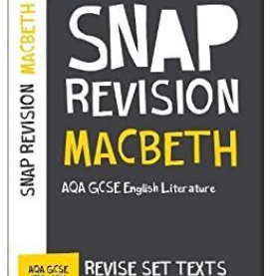
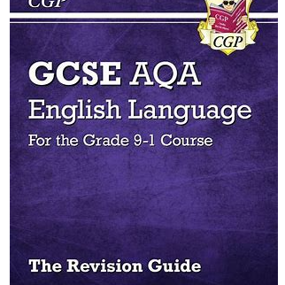
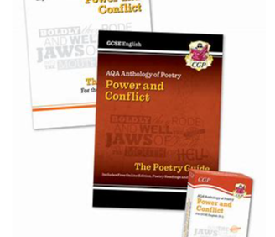
Revision Resources
YouTube:
AQA Spotlight on English
Mr Bruff
Textbooks:
AQA Revision Guides
AQA Revision cards
AQA Revision Workbooks
Snap Revision Guides
Past Papers
AQA website
In School Revision Sessions:
Tuesday afterschool

