Slide 1

Noadswood Science Department
Supporting GCSE Revision in Science

Slide 2

Key principles of Science Revision
Key Principles
Summarise 2) Memorise
3) Recall 4) Practice
Summarise key information
Videos / Revision Guides
Mindmaps
9 Box grids
Memorise core facts
Cover and test
Brainscape cards / Revision cards
Recall practice
Brainscape cards / Revision cards / HOMEWORK
Practice Questions / Past papers

Slide 3
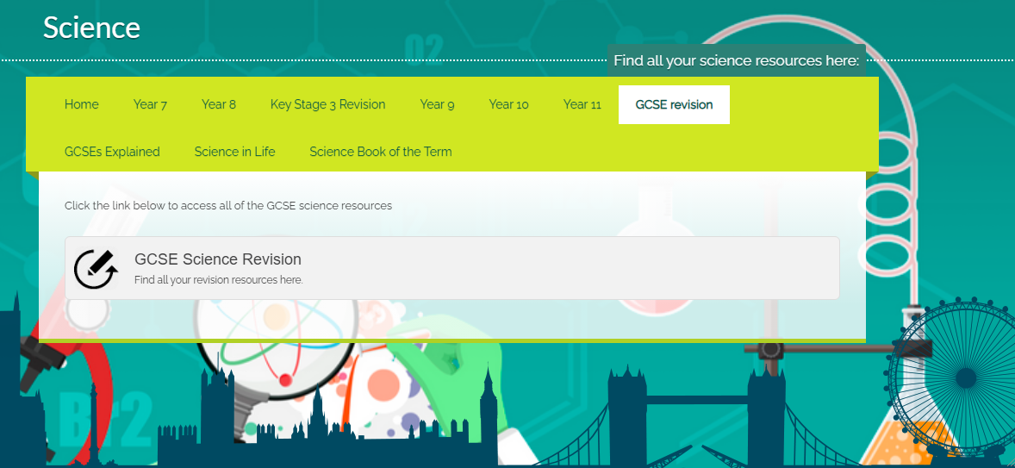
The Science Frog Page
Key Principles
Summarise 2) Memorise
3) Recall 4) Practice
Frog OS (noadswood.hants.sch.uk)

Slide 4
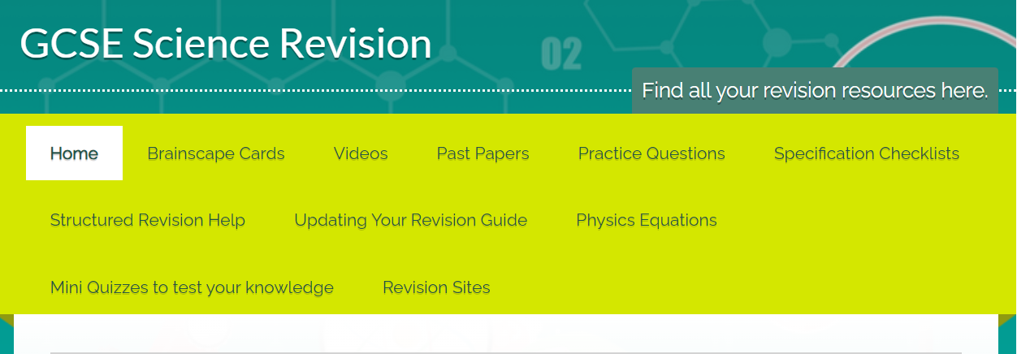
The Science Frog Page
Key Principles
Summarise 2) Memorise
3) Recall 4) Practice
Frog OS (noadswood.hants.sch.uk)

Slide 5
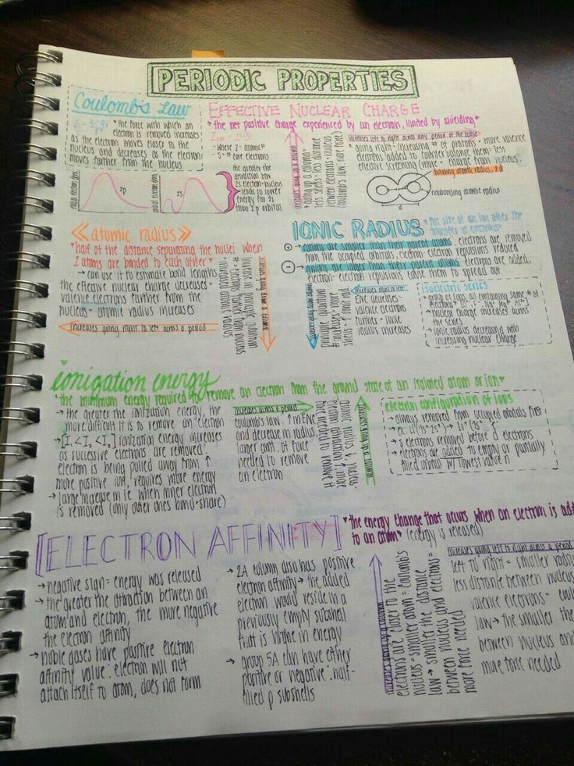
1) Summarising
Key Principles
Summarise 2) Memorise
3) Recall 4) Practice
Videos / Revision Guide
Split topics into sections (9 box grid)
Make key notes
What can we do to help?
Remind students to use videos and revision guides
Check progress
Help with time management
Organisation

Slide 6
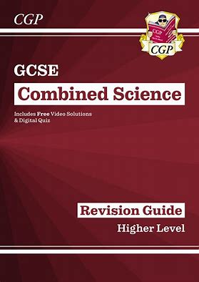
9 Box Grids
Key Principles
Summarise 2) Memorise
3) Recall 4) Practice
B4 – Bioenergetics
Photosynthesis | Rate of photosynthesis | Required Practical
Respiration | Metabolism | Anaerobic Respiration
Exercise | Extra notes
Condense this book into 25(ish) pages

Slide 7
2) Memorise 3) Recall
Key Principles
Summarise 2) Memorise
3) Recall 4) Practice
Cover and Test
Cover the information and write down as much as you can remember
Read the information and add in bits you missed
Repeat. Repeat. Repeat
Revision cards and brainscape cards
Start with a small number 4-8
Read question → Say answer → Check answer
Repeat. Repeat. Repeat
What can we do to help?
Encourage pupils to use brainscape/cards during ‘free’ time e.g. car journeys etc
Test on new material
Regularly revisit and test material already revised

Slide 8
4) Practice
Key Principles
Summarise 2) Memorise
3) Recall 4) Practice
Practice Questions and Past Papers
Complete the practice questions under exam conditions
Fill in every answer even if they do not know – best guess is better than a gap
Mark Schemes
Mark carefully, filling in corrections
Re-revise
Go back to areas they got wrong and look over their notes
What can we do to help?
Remind pupils how important exam practice is. We would not take a driving test without getting in a car!
Help with marking

Slide 9
Using Revision Cards
Key Principles
Summarise 2) Memorise
3) Recall 4) Practice
6 cards
Read question
Try to answer
Look at answer
Repeat
What can we do to help?
Being tested by someone else is better than testing yourself!

Slide 10
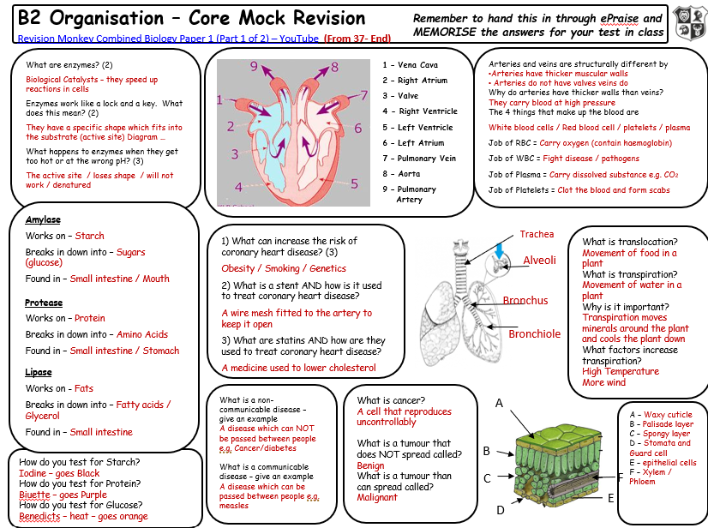
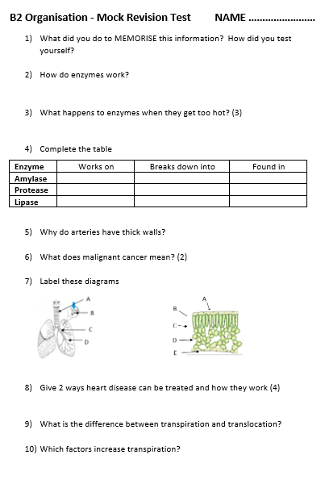
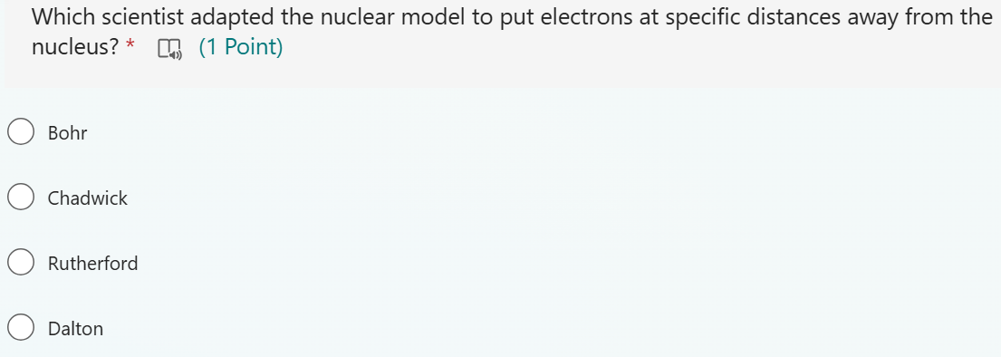
The importance of homework …
Key Principles
Summarise 2) Memorise
3) Recall 4) Practice
Regular revision of core facts
Year 11 – Summary sheet and weekly test
Year 10 – Weekly quiz on previous units

Slide 11


Key ways we can help
Key Principles
Summarise 2) Memorise
3) Recall 4) Practice
Organisation
Keeping them on Track
Checking progress
TESTING
Have they practiced questions
Encouragement ☺

