Slide 1
Prepare to Perform
Computer Science

Slide 2

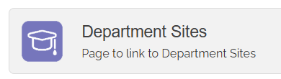

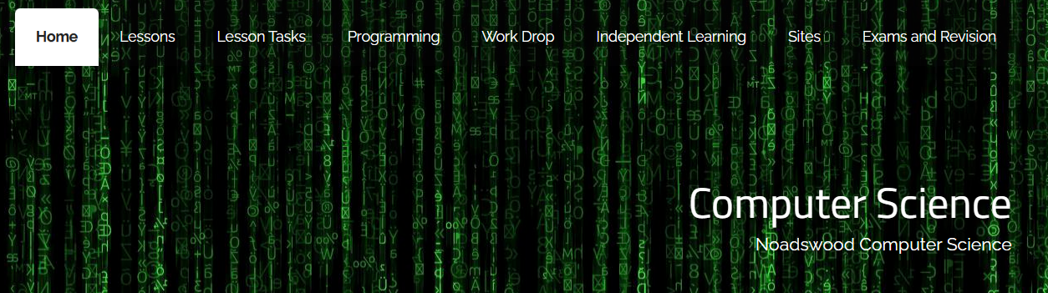
Computer Science Department Site

Slide 3
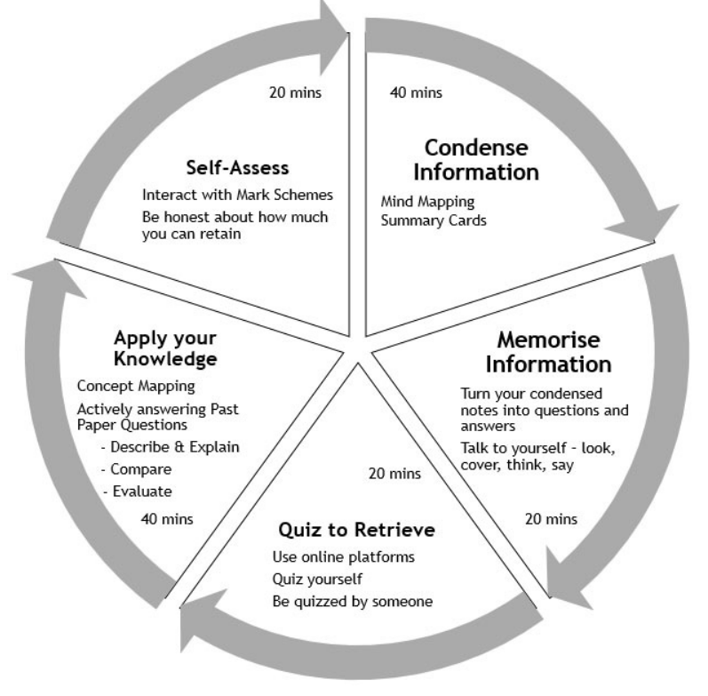
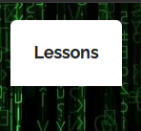
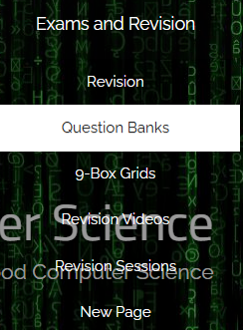
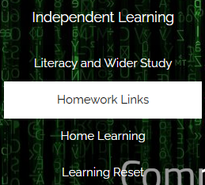
Model for revision

Slide 4

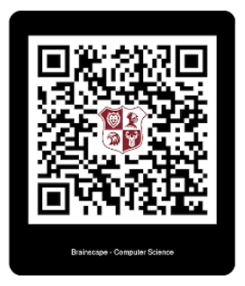

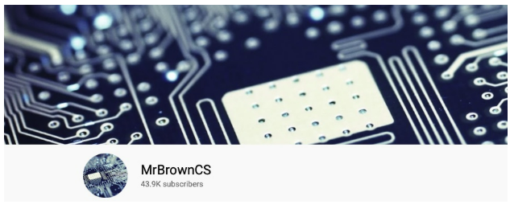
Other websites that are great for revision
kdavies45
Videos
brainscape

Slide 5
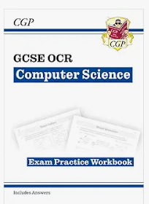
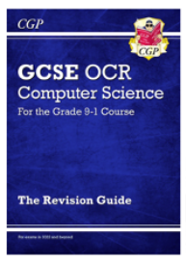
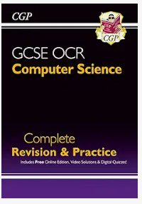
Revision books and Workbooks
Exam board OCR

Slide 6
Where to go to fill gaps in knowledge
Revision at their time of day
Revision for 4 hours a day is a lot
Do flashcards or vocab learning
Another location helps reduce boredom
Treats and rewards there
Different types of revision mixed together
Maths questions are needed to be done so good with music
Fact learning on flashcards need to really focus
Quizlet has games on to match up definitions or test knowledge
Use revision apps like study bunny
Chart revision (see subjects and rewarded)

Slide 7
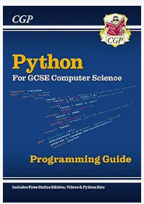
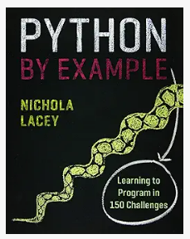
Coding

Slide 8
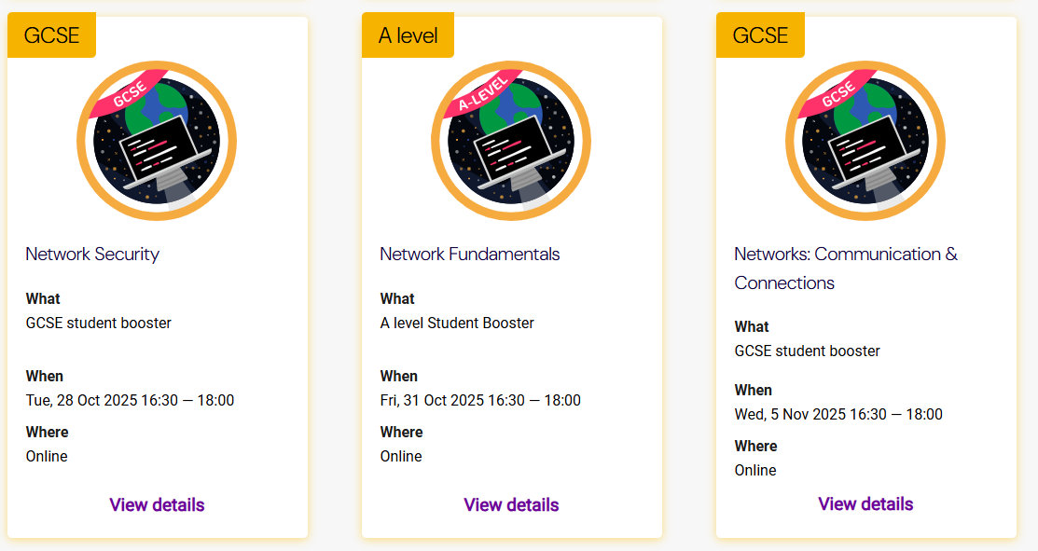
Isaac Computer Science website www.isaaccomputerscience.org/events

